Slide 1

Facility Management Performance Dashboard
Asset Health – Asset Condition (Asset API)
FDD Alerts
Energy Consumption KWH & AED
Energy Savings KWH & AED
Actuals Vs. Budget
Overall Vendor KPI %
No. of tenants with Contracts & %
Work Order – PPM on going & Completion %
Work Order – Reactive Maintenance open & overdue.
Critical Spare Availability %

Slide 2

Asset Health – Asset Condition
Module : Asset API
Data Source:
Columns : Asset condition
What to do : we need to discuss more about this Report with the team what they want to achieve , yes we have asset condition , by this what is the expected result.
Charts :

Slide 3
FDD Alerts
Data is not available team will get back to us
Module : Energy and utilities (Faults)
Data Source:
Columns :
What to do :
Charts :

Slide 4
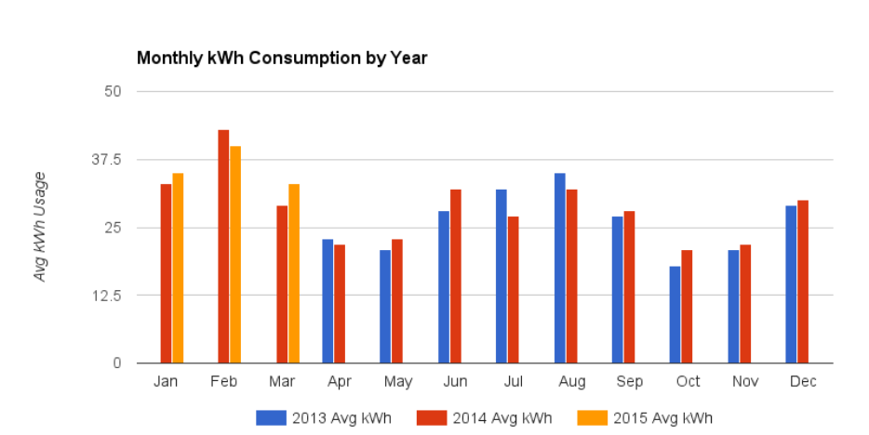
Energy Consumption(KWH & AED) Overview
Module : Energy And Utilities (Meters)
Data Source: link
Columns : Mubadala Building (MTB total electricity), Al Mamoura Building (AMA total electricity) (I.e., MTB total electricity & AMA total electricity)
What to do :Visualize the monthly energy consumption for both buildings
Charts : Stacked Column Chart or Clustered Column Chart (based on your preference)

Slide 5
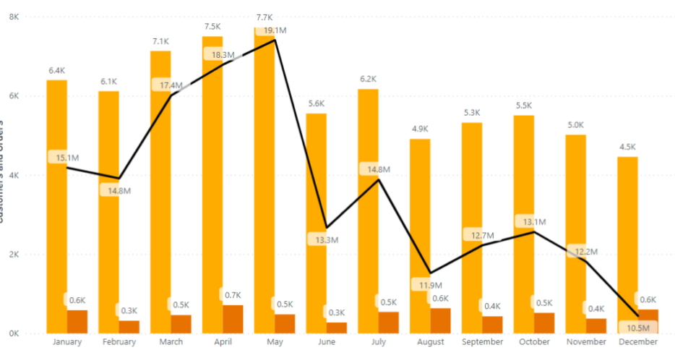
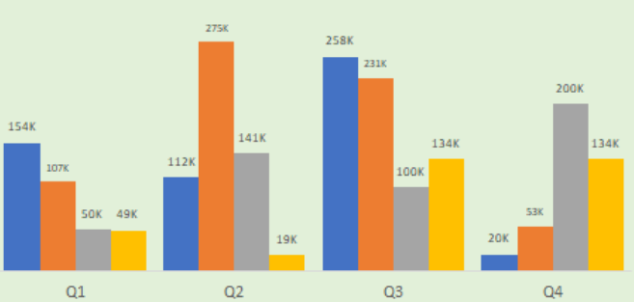
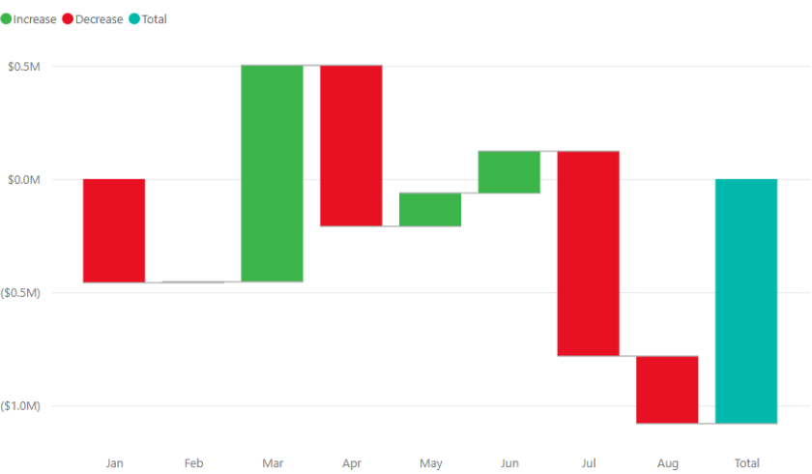
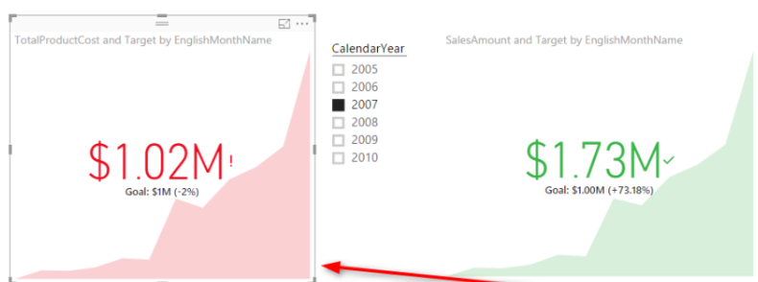
Energy saving(KWH & AED) calculations
Time Period | Best Charts | Comments
Month | Line Chart, Combo Chart
Quarter | Column Chart, Waterfall Chart
Year | KPI Visual, Column Chart
Module : Energy And Utilities (Meters)
Data Source: link
Columns : Mubadala Building (MTB total electricity), Al Mamoura Building (AMA total electricity) (I.e., MTB total electricity & AMA total electricity)
What to do : Visualize the calculated energy savings , month by month , Quarter by quarter , and year by year
Charts :Line Chart , Column Chart ,Waterfall chart KPI Visualls

Slide 6
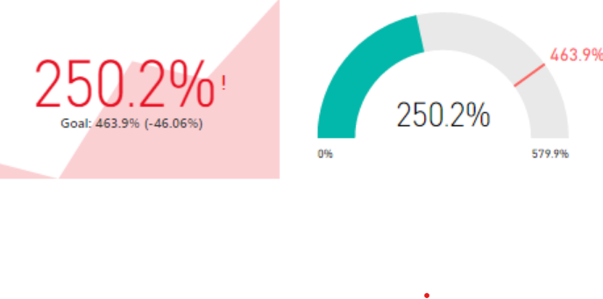
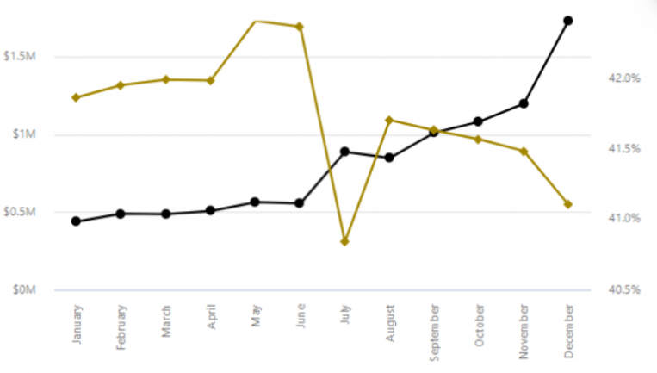
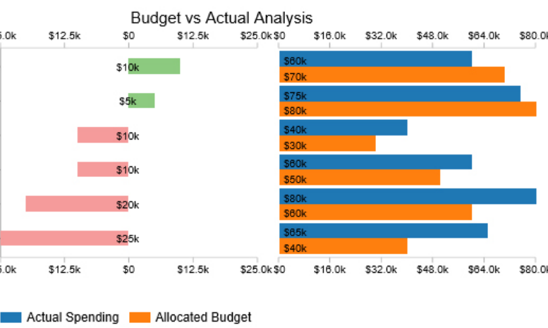
Budget analysis dashboard
Module : Budget (Budget)
Data Source: link
Columns : Budget tenants, Total budget, Actual amount, Resource id
What to do : create a budget dashboard in Power BI to track spending against allocated budgets for different tenants:
Charts : KPI Visual , Dual Line Chart

Slide 7
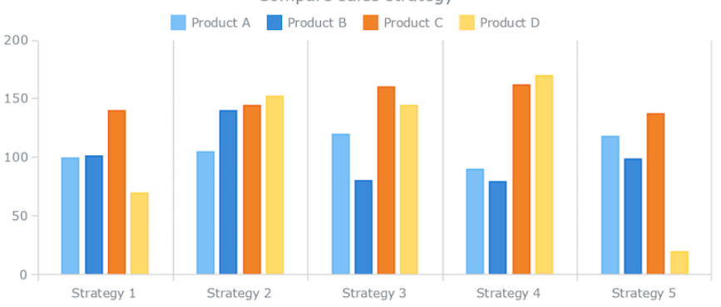
Vendor KPI Analysis
Module : Maintenance (work order)
Data Source: link
Columns : Make safe SLA , Attend SLA, Repaire SLA
What to do : Vendor KPI (SLA success percent) from Maintenance module's Work Order
Charts : Stacked Column Chart

Slide 8
Vendor KPI Analysis
Module : Maintenance (work order)
Data Source: link
Columns : Make safe SLA , Attend SLA, Repaire SLA
What to do : Vendor KPI (SLA success percent) from Maintenance module's Work Order
Charts : Stacked Column Chart

Slide 9
No. of tenants with Contracts & %
Data is not available team will get back to us
Module :
Data Source:
Columns :
What to do :
Charts :

Slide 10
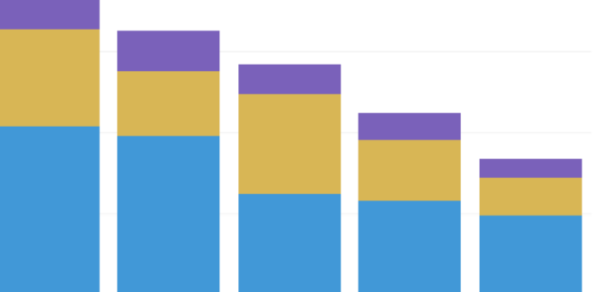
Work Order – PPM on going & Completion %
Module : Maintenance (work order)
Data Source: NA
Columns : Month ,Quarter , Year , Work order
What to do : To visualize the ongoing Work Order - Planned Preventive Maintenance (PPM) and the completion percentage, you can utilize several visualization techniques in Power BI
Charts : Stacked Bar chart

Slide 11
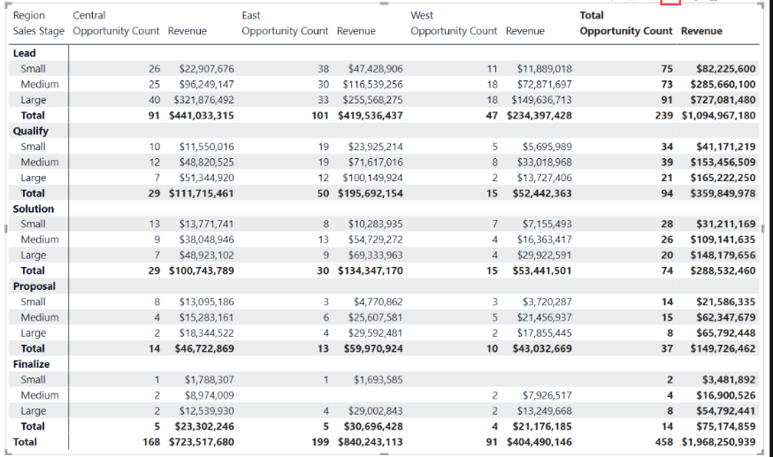
Work Order – Reactive Maintenance open & overdue
Module : Maintenance (work order)
Data Source: NA
Columns : Work Order ID ,Type, Due date,Status
What to do : To visualize the status of Reactive Maintenance work orders that are open and overdue
Charts : Table or Matrix Visualization

Slide 12
Critical Spare Availability %
Data is not available team will get back to us
Module :
Data Source:
Columns :
What to do :
Charts :

Slide 13
Queries
My question here we have different use case which are not related to each other
Suppose Asset Health is how it is related to FDD Alerts and remaining use cases how they are related to each other.
Do we need build individual reports for some the use cases

